Slide 1
Go4res: Goal-based Modeling for Reward Function Engineering and Shaping
Kenneth (Kira) H. Chan, Sol Zilberman, and Betty H.C. Cheng
Department of Computer Science and Engineering
Michigan State University
MoDRE’26
Montreal, Canada

Slide 2
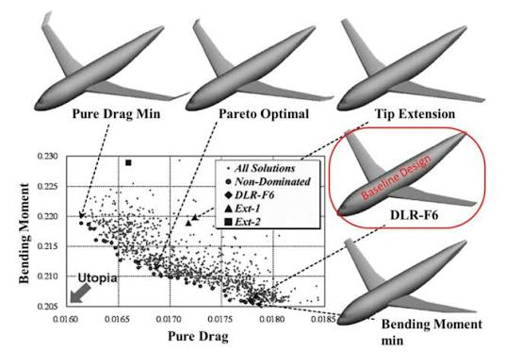
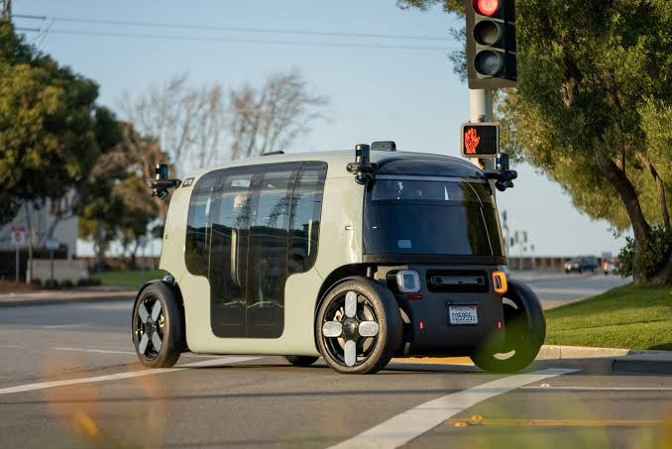

Motivation
Search and learning-based approaches increasingly solve complex problems in broad application domains [Ibrahim 2024]
  e.g., evolutionary computing (EC), reinforcement learning (RL), etc.
Guided by reward functions that specify the problem to be solved
https://www.google.com/url?sa=t&source=web&rct=j&url=https%3A%2F%2Fwww.researchgate.net%2Ffigure%2FYamazaki-et-al-11-non-dominated-solution-information-for-a-winglet-design-problem-using_fig1_320115417&opi=89978449
https://www.google.com/url?sa=t&source=web&rct=j&url=https%3A%2F%2Ffortune.com%2F2023%2F02%2F14%2Famazon-zoox-self-driving-taxis-california-robotaxis%2F&opi=89978449
https://modula.us/blog/warehouse-robotics/

Slide 3
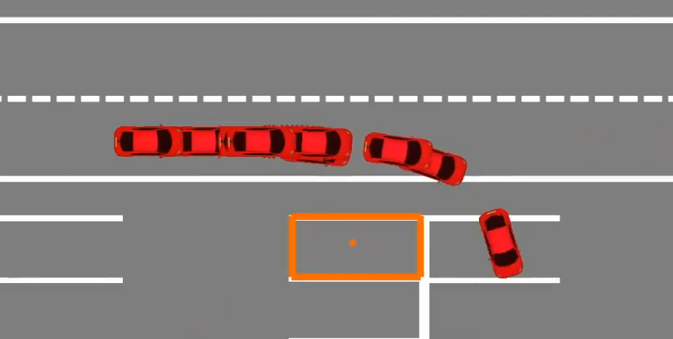

Introduction: Reward Functions
Mathematical expressions that evaluate how well a candidate solution achieves a desired objective
F(controller) = dist(car, spot)
https://www.youtube.com/watch?v=coQA9wCQ1OY
“Good” parking is more than just distance to parking spot
(e.g., how to consider safety, alignment, gap, comfort, etc.)
Notes:
Introduce simple parking example. Then show how its not enough

Slide 4
Problem: Designing reward functions is challenging
Objectives are typically high-level, informal, and difficult to operationalize
Lack of systematic process for developers to translate high-level objectives into mathematical expressions [Booth, 2023]
  Ad-hoc, trial-and-error, time consuming, etc.
Difficult to modify, analyze, and reuse
Lack of interpretability [Molnar, 2020]

Slide 5
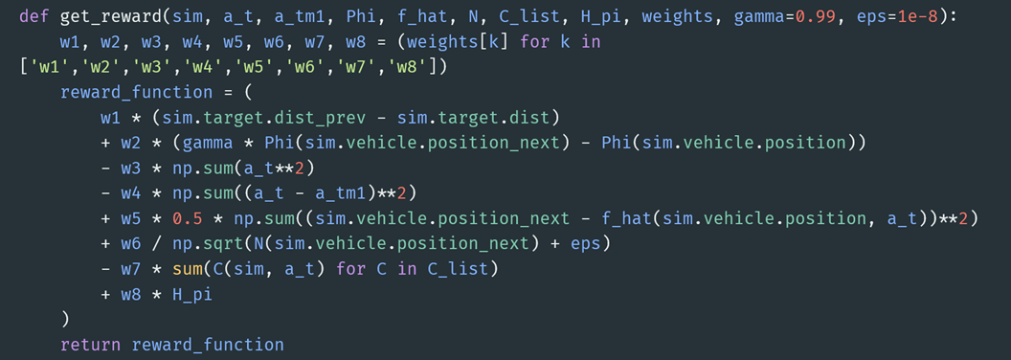
Problem: Designing reward functions is challenging
Objectives are typically informal, difficult to operationalize and modify/reuse, lack interpretability [Molnar, 2020]
Lack systematic design processes (e.g., ad-hoc, expensive, etc.)

Slide 6
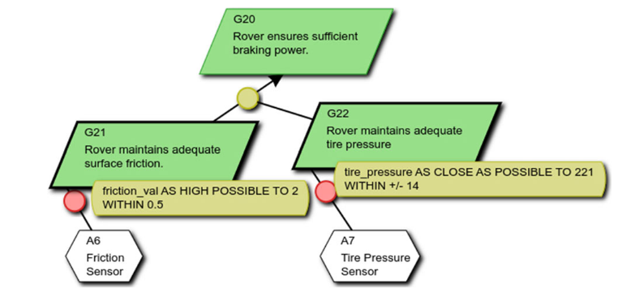
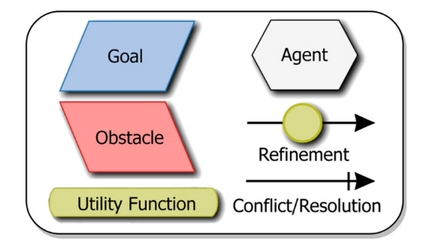
Enabling Technology: Goal-based Modeling
Hierarchical decomposition-based approach to specify a software system’s high-level goals and describe how they should be satisfied
  KAOS [Van Lamsweerde, 2001] is a graphical tree-based approach to goal-modeling

Slide 7
Key Insights
Designing rewards is in many ways similar to goal-based modeling
Synergistic integration between reward engineering and goal-based modeling provides:
  Systematic approach to reward engineering
  Modularity, traceability, and reusability of reward functions

Slide 8
Go4Res Overview
1. Specify high-level objective
2. Hierarchically decompose into functional/non-functional goals
3. Refine goals down to measurable ‘leaf nodes’
4. Annotate model with weights and utility functions
5. “Compile” into reward function
Specify high-level objectives
Specify high-level objectives
Specify high-level objectives
Specify high-level objectives
Specify high-level objectives

Slide 9
Methodology: Specify High-Level Objective
Developers codify system’s overarching objective as “root” of goal model
GS0: Park rover autonomously

Slide 10
Methodology: Hierarchical Decomposition
High-level goal decomposed into subgoals using AND/OR refinement
AND
OR
GS0: Park rover autonomously
GS0: Park rover autonomously
GS1: Park rover in available spot
GS2: Evenly-spaced parking
GS1: Park rover in available spot
GS3: Wait for available spot

Slide 11
Methodology: Refinement
Refine subgoals until we reach measurable ‘leaf’-level goals
  Leaf-level goals: concrete quantifiable requirements
GS0: Park rover autonomously
GS1: Park rover in available spot
GS1: Park rover in available spot
GS2: Evenly-spaced parking
GS4: Rover aligned with lane markers
GS5: Rover centered in spot

Slide 12
Methodology: Utility Functions
Associate mathematical utility functions with leaf-level goals that measure degree of satisficement
GS1: Park rover in available spot
GS4: Rover aligned with lane markers
GS5: Rover centered in spot
minimize(vehicle.yaw – camera.lane.yaw)
minimize(dist(GPS.pos, target.pos))

Slide 13
Methodology: System Components
Leaf level goals assigned system components that can measure goal satisficement
GS4: Rover aligned with lane markers
GS5: Rover centered in spot
minimize(vehicle.yaw – camera.lane.yaw)
minimize(dist(GPS.pos, target.pos))
GPS
camera

Slide 14
Methodology: Weights
Edges are labeled with weights, enabling prioritization of different subgoals
GS0: Park rover autonomously
0.3
0.7
GS1: Park rover in available spot
GS2: Evenly-spaced parking

Slide 15
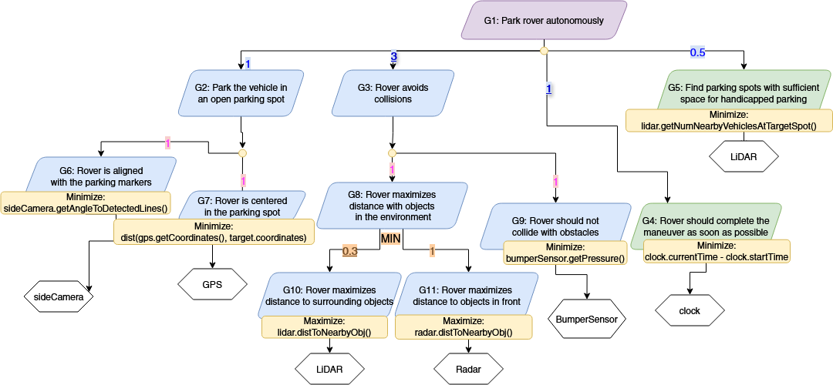
Methodology: Reward Compilation
Goal tree automatically traversed and compiled into executable reward function

Slide 17
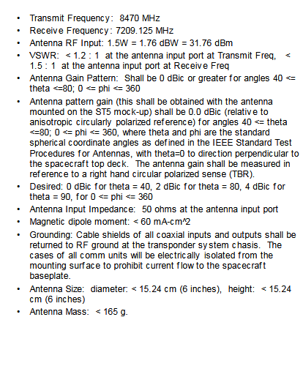
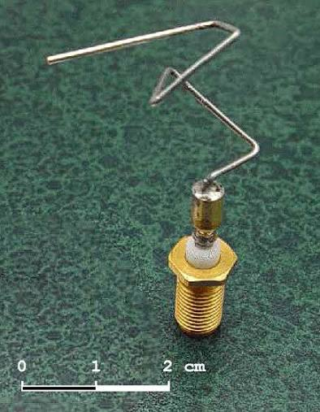
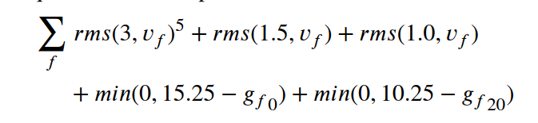
Use Case: EC for Antenna Design
Evolutionary search for optimal antenna design [Hornby, 2006]
Natural language requirements
https://www.giss.nasa.gov/staff/mway/ROSES2006/hornby.pdf
Notes:
Mention challenges with original reward/experimentation

Slide 18
Use Case: EC for Antenna Design
Representing antenna design in Go4Res
Separate functional/non-functional goals, weighting scheme, automatically generate new reward function, interpretability

Slide 19
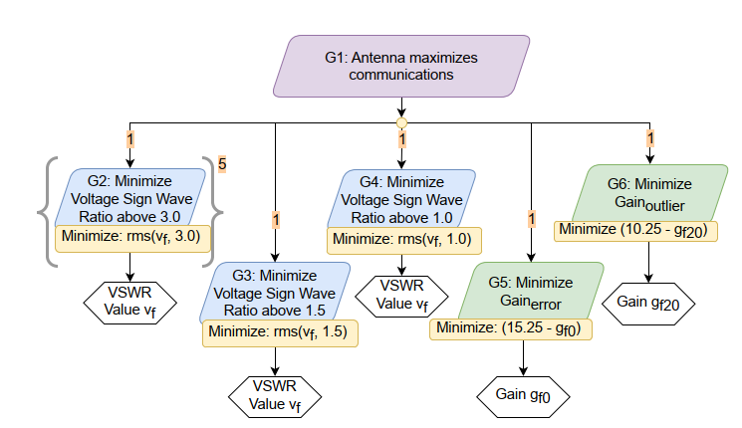
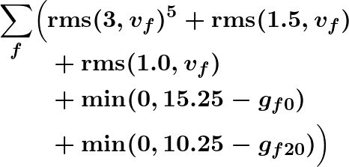
Use Case: EC for Antenna Design
Original reward function

Slide 20
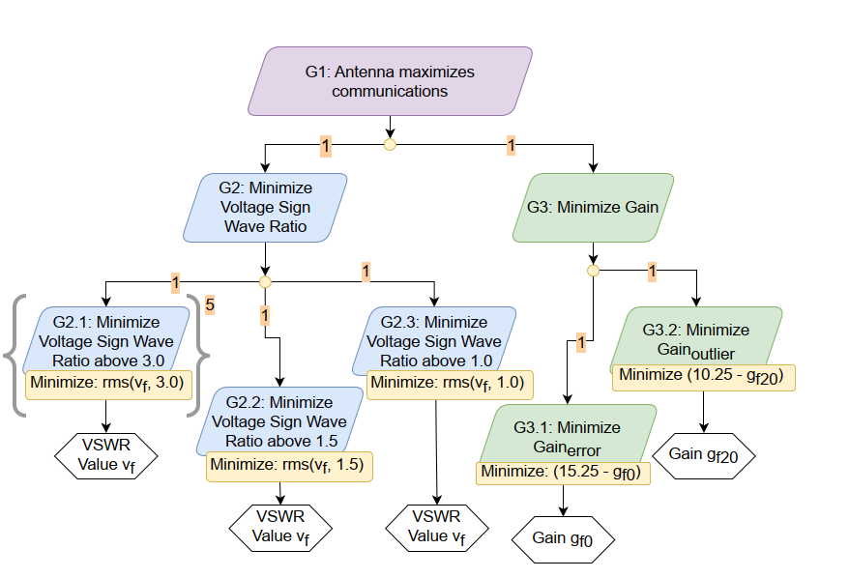
Introducing abstraction
Flat reward function
Functional tree
Non-functional tree

Slide 21
Discussion
High-level representation of complex problem spaces
“Separation of concerns” and traceability in reward function design
Modularity provides ease of modification and experimentation

Slide 22
Conclusion
Go4Res is a goal-based modeling approach to engineer reward functions for SBSE
  A systematic means to reason about the decomposition of high-level goals into measurable low-level objectives
  Supports modularity, reusability, and traceability in the development of reward functions
Demonstrated Go4Res in two use cases in different SBSE techniques across different application domains

Slide 23
Next Steps
Explore the application of Go4Res in game-based settings for uncertainty discovery
Specify Go4Res as a domain-specific modeling language
Graphical support for the framework
Support reuse within and between use cases

Slide 24
References
[Ibrahim, 2024] S. Ibrahim, M. Mostafa, A. Jnadi, H. Salloum, and P. Osinenko, “Comprehensive overview of reward engineering and shaping in advancing reinforcement learning applications,” IEEE Access, 2024.
[Booth, 2023] S. Booth et al., “The perils of trial-and-error reward design: misdesign through overfitting and invalid task specifications,” in Proceedings of the AAAI Conference on Artificial Intelligence, vol. 37, pp. 5920–5929, 2023.
[Molnar, 2020] C. Molnar, G. Casalicchio, and B. Bischl, “Interpretable machine learning–a brief history, state-of-the-art and challenges,” in Joint European conference on machine learning and knowledge discovery in databases, pp. 417–431, Springer, 2020.
[Van Lamsweerde, 2001] A. Van Lamsweerde, “Goal-oriented requirements engineering: A guided tour,” in Proceedings fifth IEEE international symposium on requirements engineering, pp. 249–262, IEEE, 2001
[Hornby, 2006] G. Hornby, A. Globus, D. Linden, and J. Lohn, “Automated antenna design with evolutionary algorithms,” in Space 2006, p. 7242, Aerospace Research Central, 2006.

Slide 25
Questions?
Takeaways
  Go4Res is a goal-based modeling approach to engineer reward functions for SBSE
  A systematic means to reason about the decomposition of high-level goals into measurable low-level objectives
  Supports modularity, reusability, and traceability in the development of reward functions
Next Steps
  Explore the application of Go4Res in game-based settings for uncertainty discovery
  Provide formalization of Go4Res language, in addition to graphical front end for the framework

